Slide 1

PT4053:
Sources of Information: Databases
Walaa Abu-Taleb

Slide 2
Learning outcomes
Comprehend the fundamental concepts of databases and the hierarchy of evidence.
Appreciate the significance of utilizing databases and conducting evidence-based searches.
Identify key sources for literature reviews, including databases, clinical guidelines, and peer-reviewed publications.
Recognize the essential steps involved in evidence retrieval, including formulating PICO questions and employing various search techniques.

Slide 3

Databases
A database is an online collection of searchable information.
Many databases specialize in offering credible, scholarly sources like academic journal articles, while others focus on more popular sources such as newspaper or magazine articles or trade publications.
These sources are generally organized by some combination of date, author, title, subject or publication type.
Some databases might search within one specific field or discipline, while others might search across different disciplines.

Slide 4

What are ‘levels of evidence’?
Evidence is published across a variety of sources, including scientific or academic journals, books, conference proceedings, websites, and news reports.
Academic publications in scientific journals are generally considered to be of higher quality due to the independent, peer-review process.
There are a number of ways to determine the quality of a journal, though these measures are not necessarily a good proxy of the quality of individual articles within the journal.
A central principle in evidence translation is that all evidence must be critically appraised, regardless of its source.

Slide 5
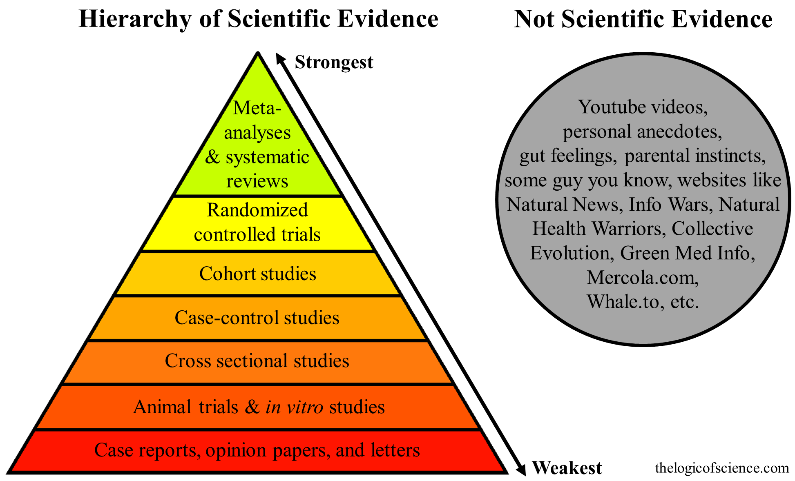
What are ‘levels of evidence’?
The Levels of Evidence Pyramid can be utilised to weigh the quality of different types of evidence when engaging in evidence translation, with the highest level of evidence at the top.

Slide 6
I have limited time to search for and appraise evidence.
Where do I start?
Maximise your time by consulting up-to-date, reliable sources that provide clinical recommendations following critical appraisal of the evidence in a particular area (i.e. filtered resources at the top of the Levels of Evidence Pyramid).
Systematic reviews and meta-analyses attempt to bring together all the relevant studies on a particular topic, sometimes with conflicting findings, and synthesise their results.
A well-done systematic review is conducted in a transparent and objective manner, and includes critical appraisal of the quality of individual studies in order to minimise error and bias.

Slide 7
Cochran Database of Systematic Reviews
Widely recognised as the ‘gold standard’ in systematic reviews due to the rigorous methodology used.
• Reviews feature a ‘plain language summary’ that provides a quick, easy-to-understand overview of findings.
• Reviews are periodically updated to reflect new evidence.
Where available, clinical practice guidelines with evidence-based recommendations are another form of filtered information, and can assist with decision- making in specific clinical circumstances.

Slide 8
Guidelines:
NHMRC Australian Clinical Practice Guidelines
Portal allows you to search for guidelines relevant to the Australian context that are current and freely available.
National Institute for Health and Care Excellence (NICE) guidelines (UK) based on the best available evidence that is regularly updated as well as input from service users and clinicians.
The Agency for Healthcare Research and Quality (USA)
National Guideline Clearinghouse provides summaries of clinical practice guidelines. Guidelines range from expert opinion to higher levels of evidence

Slide 9
Academic databases to find peer-reviewed publications
PubMed is a user-friendly search interface that provides free online access to the MEDLINE database of published academic literature.
Clinical Queries is a special feature that allows you to filter results to specific clinical study categories such as aetiology, diagnosis, therapy, or prognosis.

Slide 10
Free evidence search engines
Google Scholar
• Basic search interface that is fast gaining popularity for quick and comprehensive clinical searches.
• Generally, performs well in head-to-head comparisons with major academic databases and may provide greater access to free full-text articles. 3–5
• Improvements in recent iterations address some previous criticisms, though shortcomings remain, and it should not be used in isolation for systematic review searches.
• In addition to peer-reviewed publications, also retrieves ‘grey literature’ (i.e. documents not catalogued by commercial publishers, like non-peer reviewed articles, theses and dissertations, and academic books).
While this can broaden the search results, bear in mind that some of the articles retrieved through this platform may not have gone through a stringent peer-review process

Slide 11
The following search engines aim to link to high quality evidence, with full text articles freely available in some cases.
Search results can range from systematic reviews and evidence summaries to broader sources of evidence like guidance, policy documents, and decision aids.
NICE Evidence Search
PDQ-Evidence
Trip Database offers advanced search option that allows for input based on the PICO framework.

Slide 12
Finding the Evidence:
Step of the process:
Asking answerable questions
Identifying synonyms and building search strategies
Identifying appropriate information sources
Searching for evidence
Appraising results

Slide 13
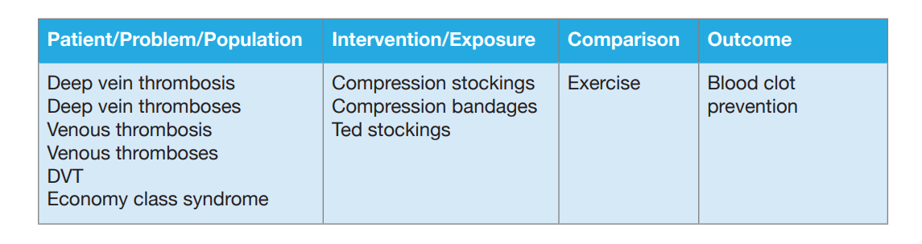
1- PICO Questions
    This framework (PICO) helps determine:
    • Population of interest
    • Intervention or treatment you’re interested in
    • Comparison that’s important or relevant to consider
    • Outcome of interest.

Slide 14
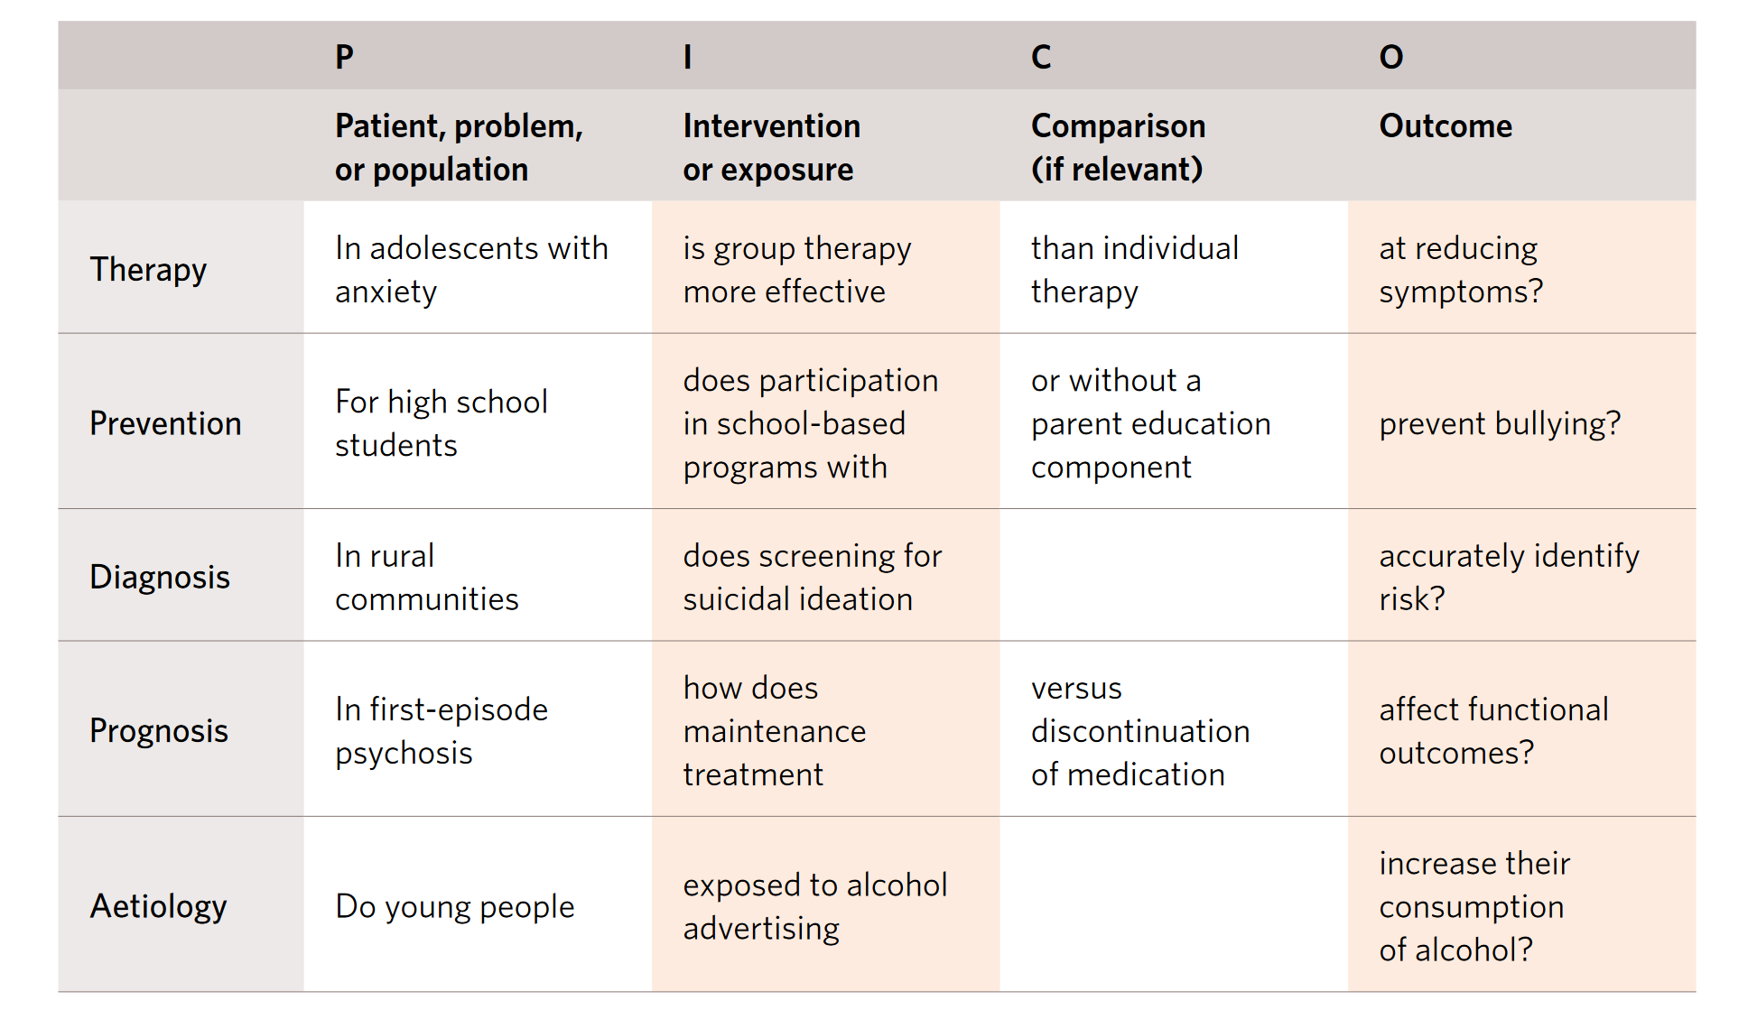
PICO Examples

Slide 15
Finding the Evidence:
Step of the process:
Asking answerable questions
Identifying synonyms and building search strategies
Identifying appropriate information sources
Searching for evidence
Appraising results

Slide 16
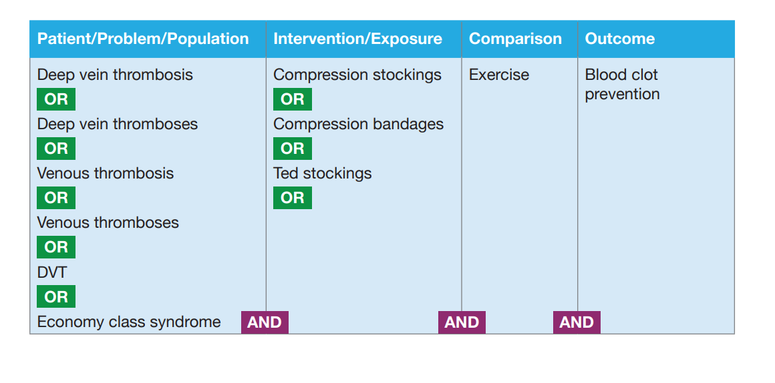
Identify synonyms and build search strategy
Once you have all the relevant columns populated with the key concepts and related terms, then it is time to combine them.
Within each column, you combine all the terms using the Boolean operator OR. Then, when those have all been combined, you combine all the columns with the Boolean operator AND.

Slide 17
Identify appropriate information sources
Health information portals
Clinical databases
NICE Evidence Search, and the TRIP Database are both filtered search engines.
Clinical databases: The Cochrane Library, PubMed/Medline and Embase.
The Cochrane Library (http://www.thecochranelibrary.com/) contains the highest quality systematic reviews, but only for a limited number of clinical topic areas.
To find other systematic reviews, PubMed/Medline and Embase
CINAHL (Cumulative Index of Nursing and Allied Health Information).
PsycInfo contains abstracts of research from journals related to mental health and psychology.
The Campbell Collaboration is the social care version of the Cochrane Collaboration

Slide 18
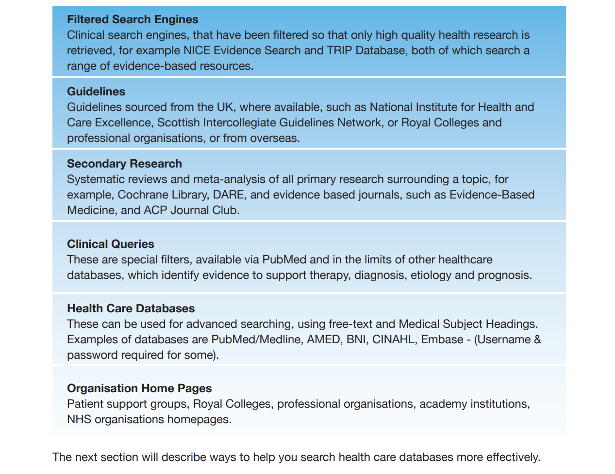
Search for Evidence

Slide 19
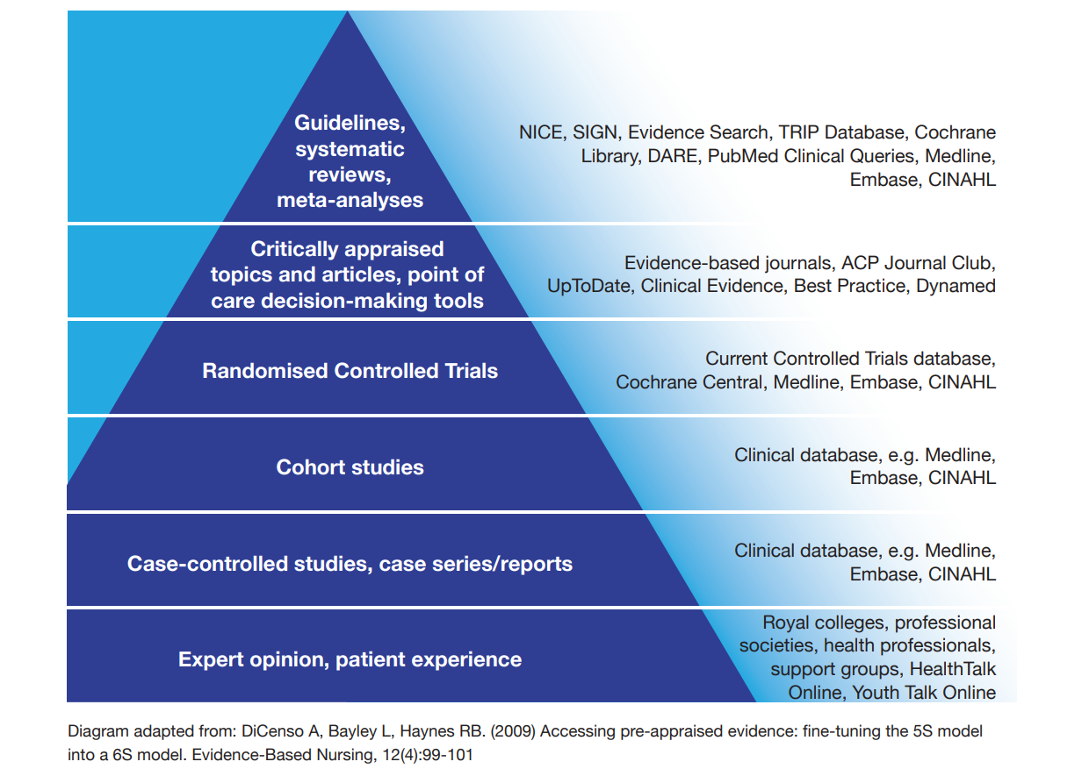
Hierarchy of Evidence

